Slide 1
Analysis about Opening a Supplements Shop in Manhattan

Slide 2
Manhattan
Manhattan, often referred to by residents of the New York City area as the City, is the most densely populated of the five boroughs of New York City, and coextensive with the County of New York, one of the original counties of the U.S. state of New York. Manhattan serves as the city's economic and administrative center, cultural identifier, and historical birthplace.

Slide 3
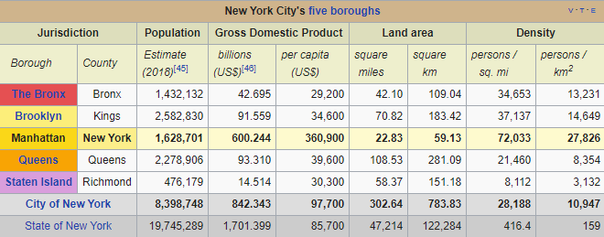

Slide 4
A fitness supplements shop is very profitable for several reasons. One of the reason is online shopping is not trusted since there are too many fake products and getting fake product is pretty possible.
Providing possible consumers to access their supplements on-hand experience is beneficial for customers

Slide 5
Data Acquisition and Cleaning
Fundamental information about Manhattan is derived from Wikipedia page of Manhattan (https://en.wikipedia.org/wiki/Manhattan)
Geographic dataset is derived from NYU Spatial Data Repository (https://geo.nyu.edu/catalog/nyu_2451_34572)
Average rent information which is last updated January 2020 is gathered from rentcafe.com (https://www.rentcafe.com/average-rent-market-trends/us/ny/manhattan)

Slide 6
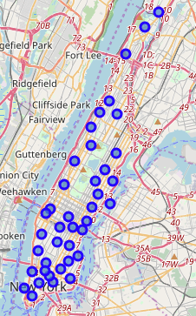
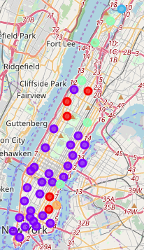
Neighborhoods

Slide 7
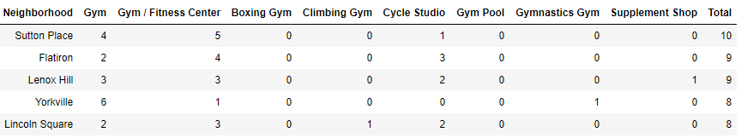
An illustration of derived data frame

Slide 8
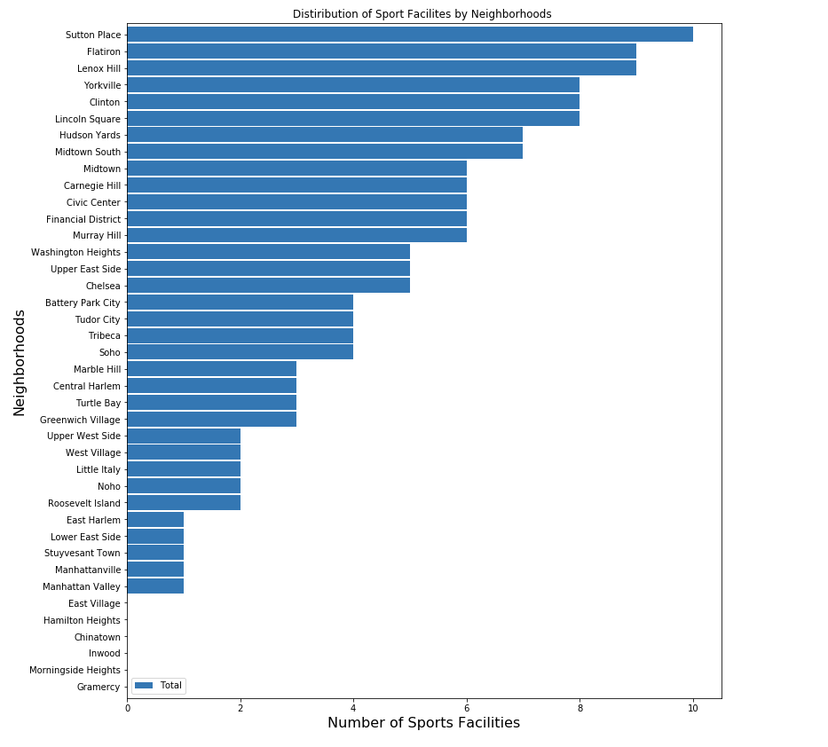
Total number of sport facilities

Slide 9
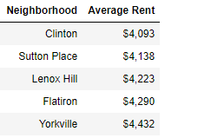
Rental information of top 5 neighborhood

Slide 10
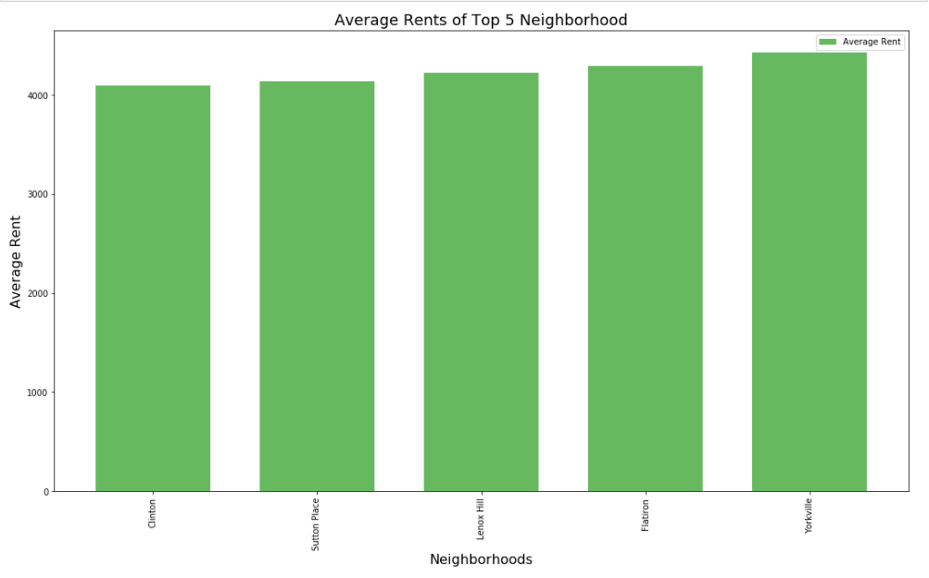
Continued

Slide 11
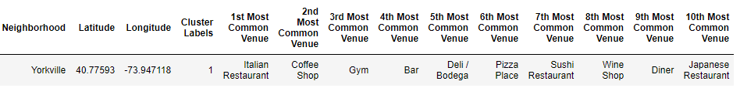
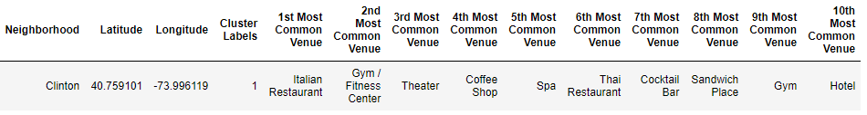
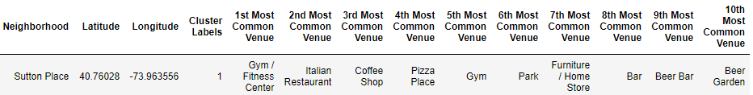
Common venues for each neighborhood

Slide 12
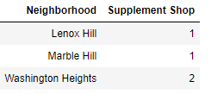
Numbers of exist supplement shops

Slide 13
Conclusion
1. Sutton Place
Sutton Place has the highest number of sports facilities with no other supplement shop around. Moreover, its most common venues highly rely on sports facilities. Also, its rental situation is suitable since it is the second cheapest neighborhood amoung them. All in all, all these statics makes Sutton Place as the best option to open a supplement shop.

Slide 14
2.Flatiron
Like Sutton Palace, Flatiron also do not have any supplement shops in the region. Moreover, it has the second highest number of sport facilities. Also, sports facilities take up space in the most common venues. Finally, Flatiron is the second best option right after Sutton Place.

Slide 15
3. Clinton
Clinton has the cheapest rent among others. That makes it a desirable option. However, Yorkville and Clinton have exactly same number of sports facilities. Although their statistics look similar, when I observed I noticed a small difference in the most common venues. Clinton has two sports related common value while Yorkville has only one in the top ten common venues. So Clinton becomes a better option to locate a supplement shop.

Slide 16
4. Yorkville
Yorkville has the most expensive rents. However, it is a better choice when compared to Lenox Hill. Because there is no other supplement shop in this neighborhood, unlike Lenox Hill.

Slide 17
5. Lenox Hill
Since there has already been a supplement shop and rent average is nothing special Lenox Hill is not a favorite location among the others.

Slide 18
References
https://en.wikipedia.org/wiki/Manhattan
https://geo.nyu.edu/catalog/nyu_2451_34572
https://www.rentcafe.com/average-rent-market-trends/us/ny/manhattan

